Slide 1
Data Preprocessing
Week 2
Edward Ombui, PhD

Slide 2
Objectives
Understand the importance of data preprocessing in the machine learning pipeline.
Learn techniques for cleaning and transforming raw data into a suitable format for analysis.
Explore methods for exploratory data analysis (EDA) to gain insights into the dataset.

Slide 3
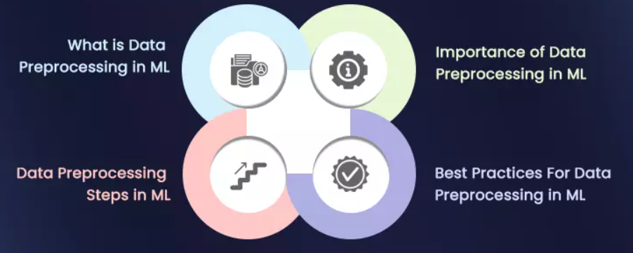

Slide 4
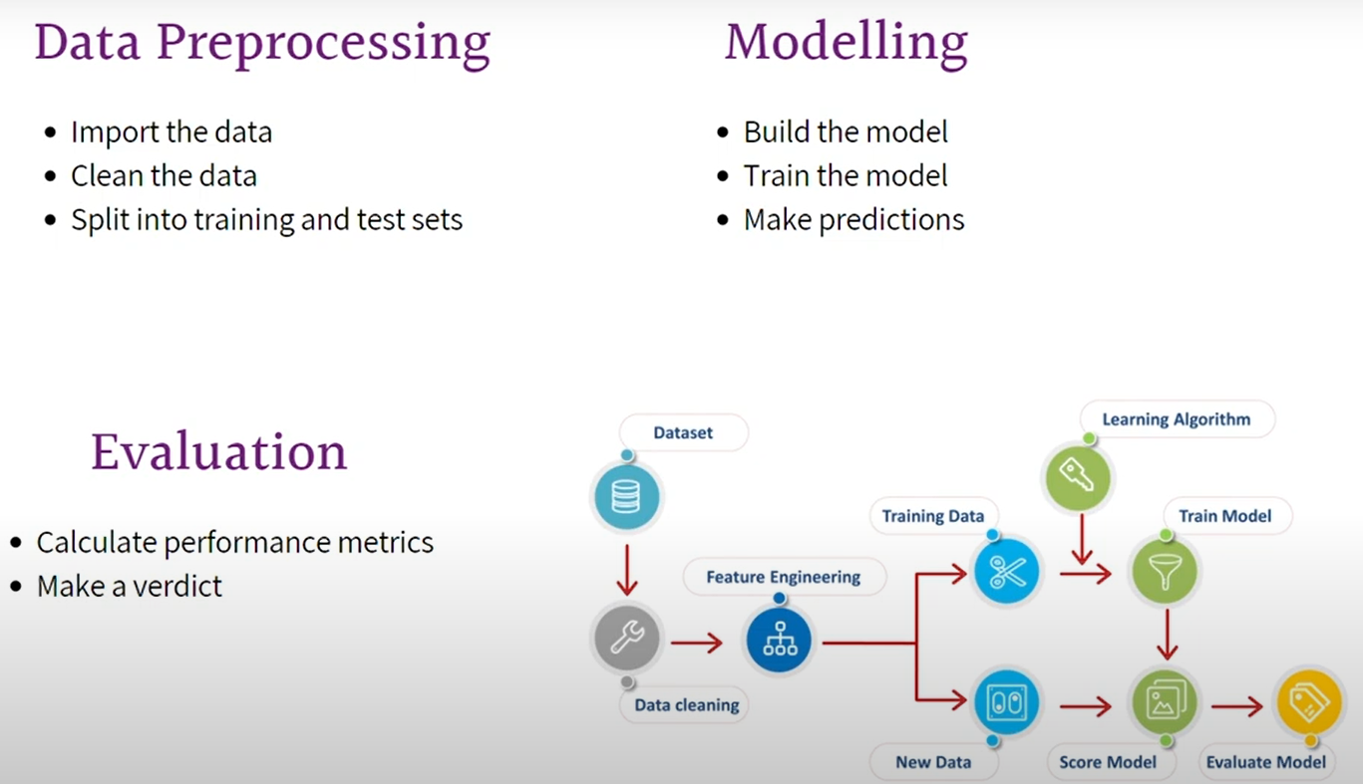

Slide 5
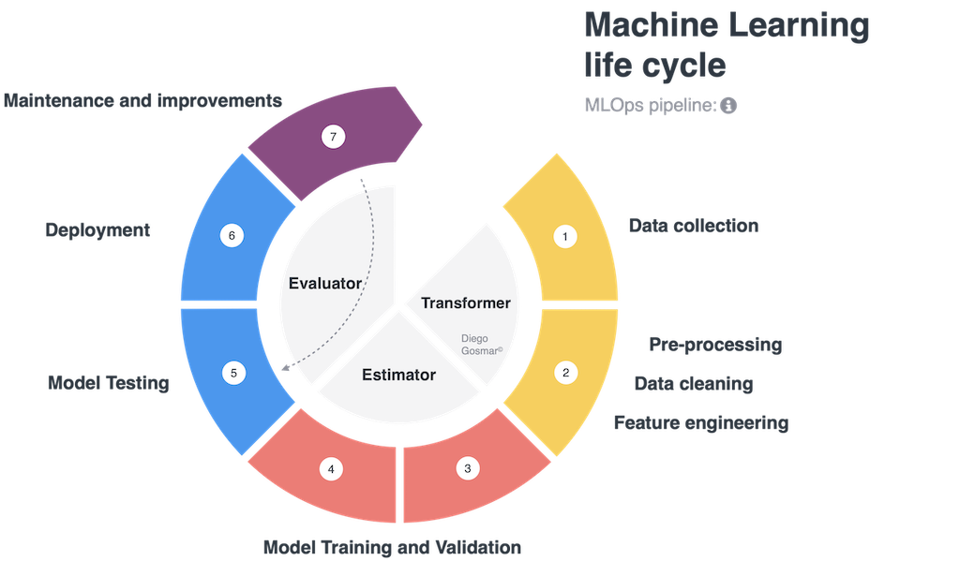
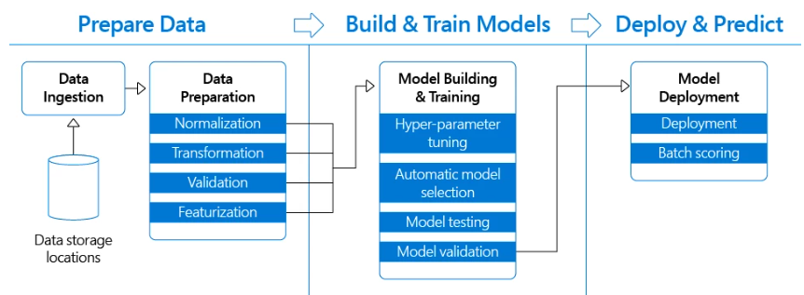
Machine Learning Pipeline

Slide 6
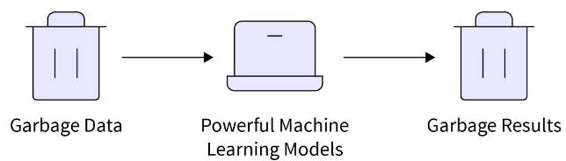
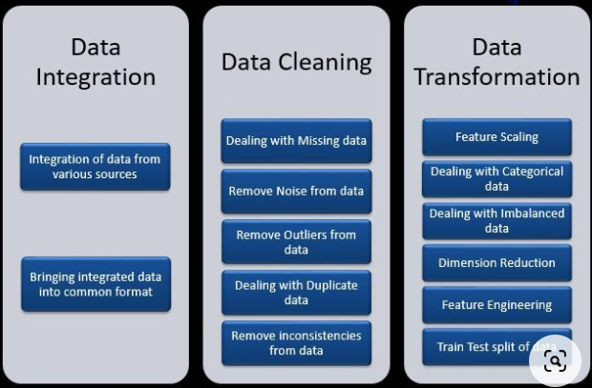
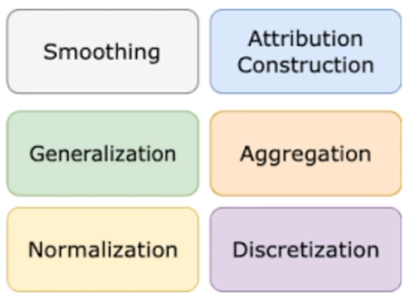
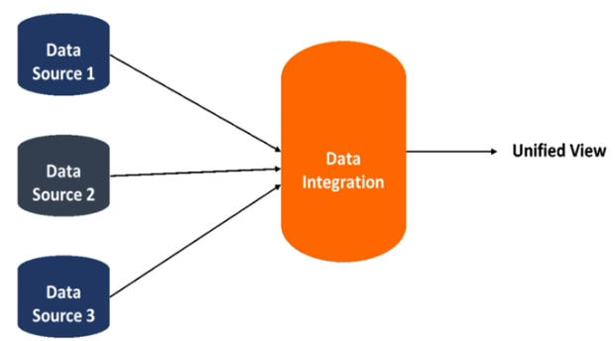
Importance of Data Preprocessing
Improving Data Quality
Dealing with Missing Values
Normalizing and Scaling
Handling Outliers
Algorithm Compatibility
Performance
Feature Engineering

Slide 7
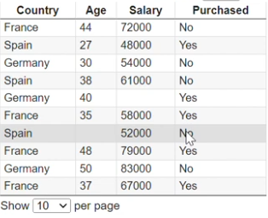

Slide 8
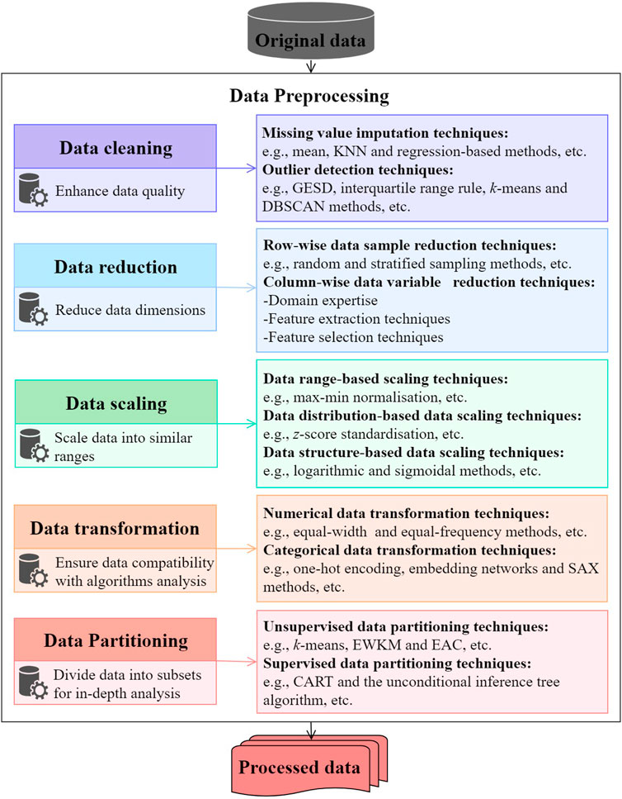
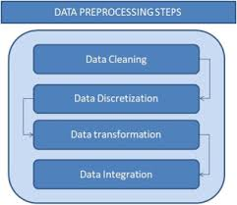
Notes:
Data preprocessing in machine learning is the practice of cleaning and organising raw data to prepare it for model training. Raw data is seldom in the ideal format for machine learning algorithms, and it often contains inconsistencies, missing values, or outliers.
Preprocessing in machine learning encompasses all the activities that make the data suitable for model training. It is the series of steps that ensure your data is in the right format, contains accurate information, and is compatible with the chosen machine learning algorithm.
Without proper machine learning preprocessing, model training can be fraught with issues, leading to inaccurate predictions and poor performance.

Slide 9
Steps in preparing an unstructured text document for deeper analysis
Tokenization
Sentence Breaking
Part of Speech Tagging
Chunking
Syntax Parsing
Sentence Chaining

Slide 10
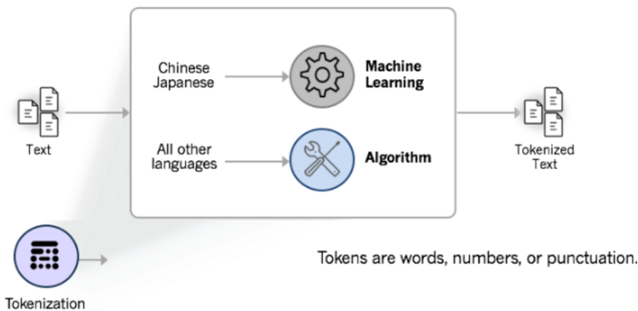
Tokenization
Breaking a text document into pieces that a machine can understand, such as words.
But how do you teach a machine learning algorithm what a word looks like?
Logographic languages like Mandarin Chinese have no whitespace.This is where we use machine learning for tokenization.
Tokenization is language-specific, each lang has its own tokenization requirements
Chinese follows rules and patterns just like English, and we can train a machine learning model to identify and understand them
For most alphabetic languages, we can rely on rules-based tokenization.
Notes:
Tokenization is language-specific, and each language has its own tokenization requirements. English, for example, uses white space and punctuation to denote tokens, and is relatively simple to tokenize.
Many logographic (character-based) languages, such as Chinese, have no space breaks between words. Tokenizing these languages requires the use of machine learning

Slide 11
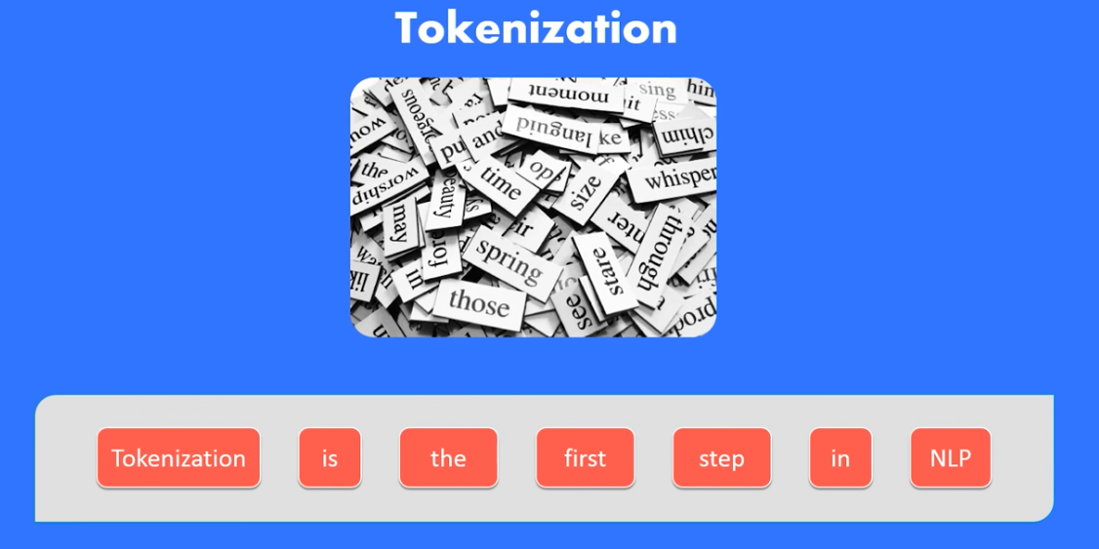

Slide 12
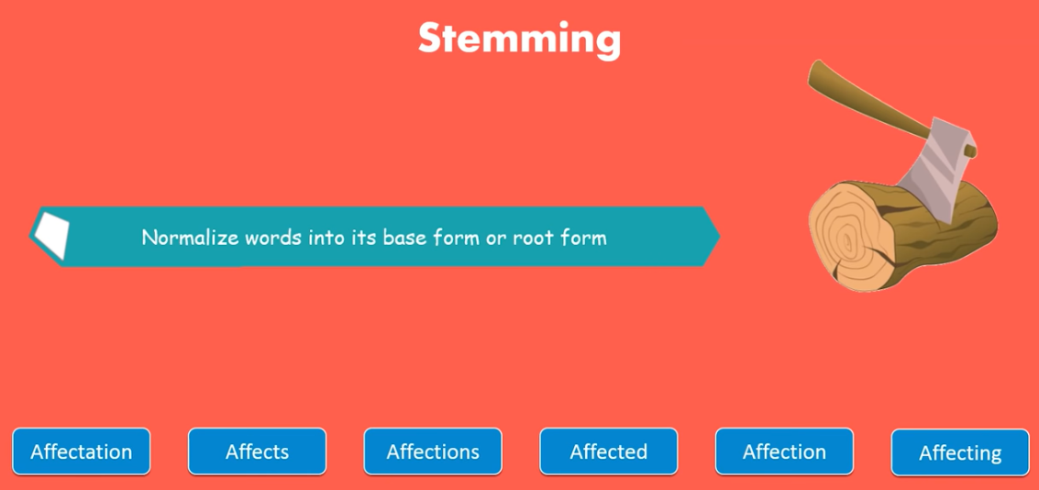

Slide 13
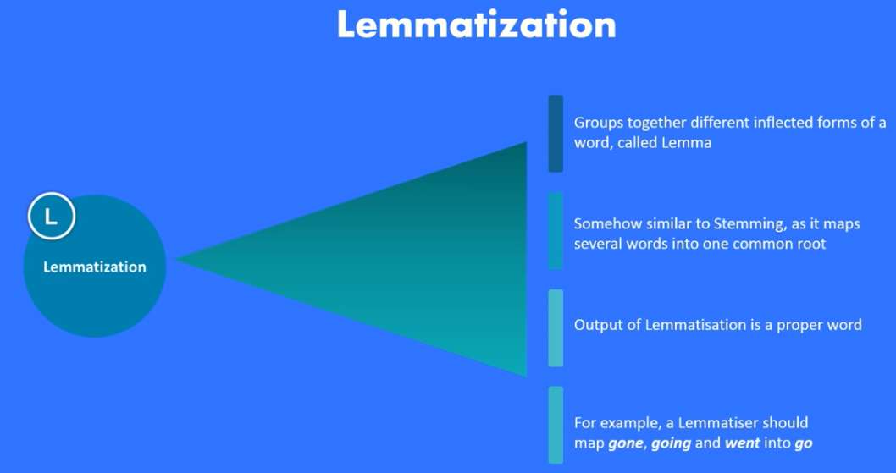

Slide 14
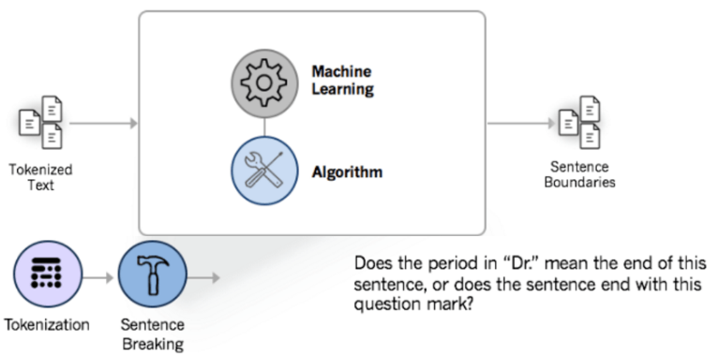
Sentence Breaking
Notes:
before you can run deeper text analytics functions (such as syntax parsing), you must be able to tell where the boundaries are on a sentence. Sometimes it’s a simple process, and other times… not so much

Slide 15
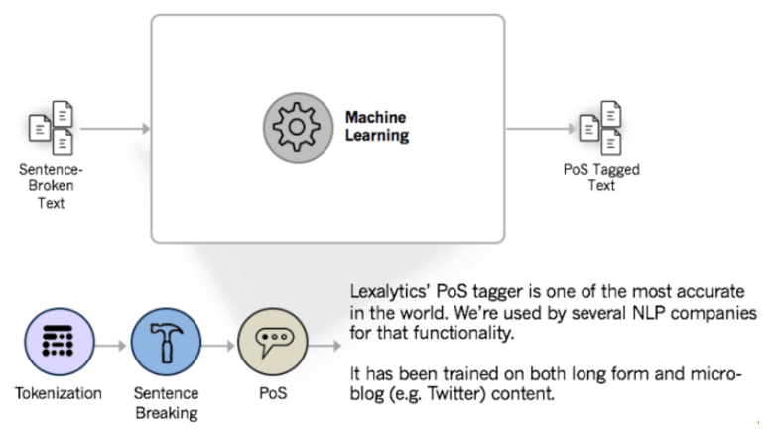
Part-of-Speech tagging
(PoS tagging) means identifying each token’s part of speech (noun, adverb, adjective, etc.) and then tagging it as such
We need to correctly identify Parts of Speech in order to recognize entities, extract themes, and to process sentiment

Slide 16
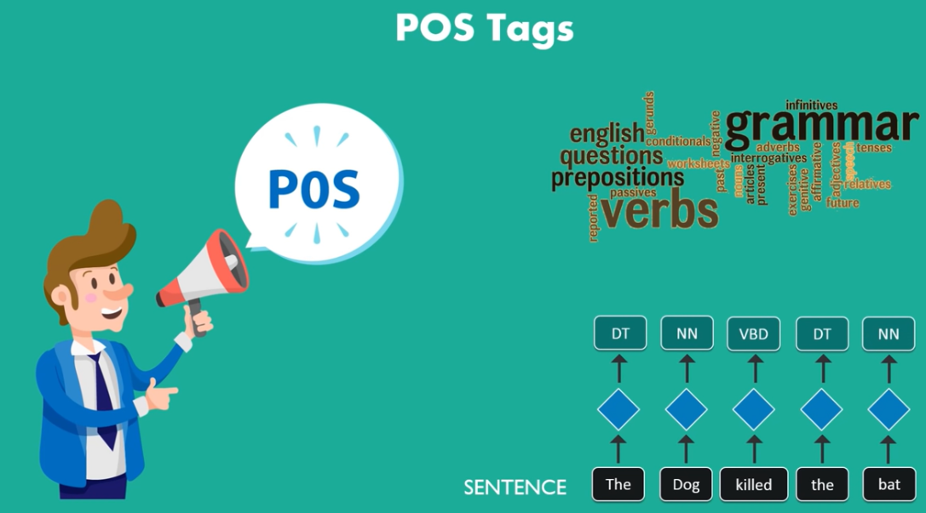

Slide 17
Named Entity Recognition
Named entities are people, places, and things (products) mentioned in a text document.
However, entities can also be hashtags, emails, mailing addresses, phone numbers, and Twitter handles.
Named Entity Recognition models rely on accurate PoS tagging from those models.

Slide 18
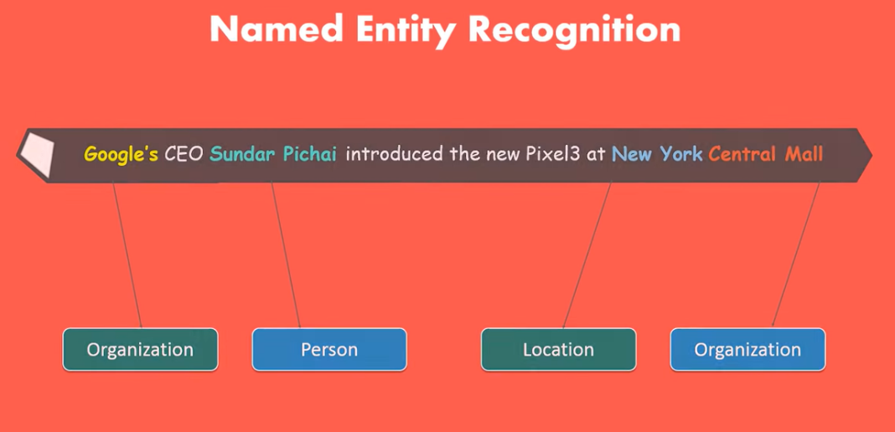

Slide 19
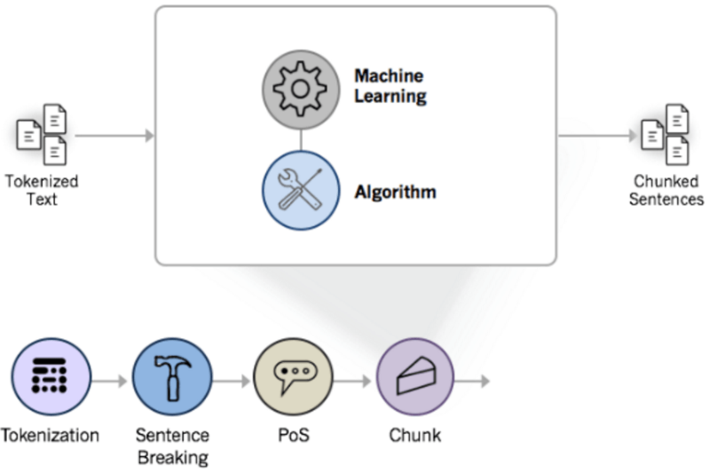
Chunking
Chunking means assigning PoS-tagged tokens to phrases
[the tall man]_np [is going to quickly walk]_vp [under the ladder]_pp

Slide 20
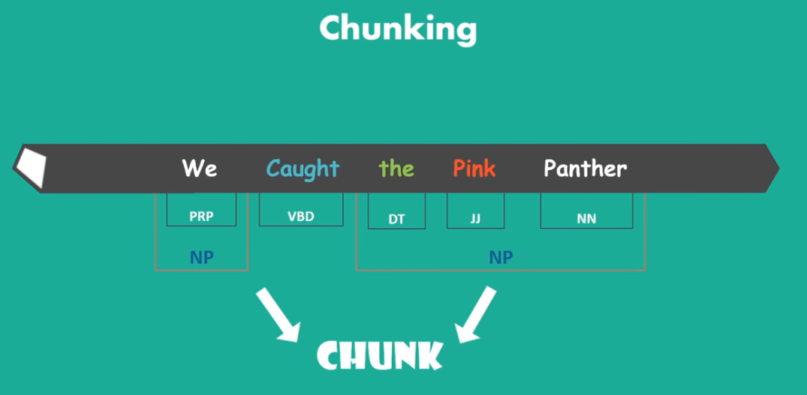

Slide 21
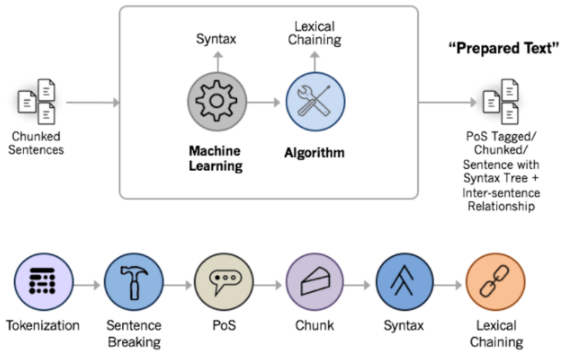
Syntax Parsing
The syntax parsing sub-function is a way to determine the structure of a sentence.
Notes:
The syntax parsing sub-function is a way to determine the structure of a sentence. In truth, syntax parsing is really just fancy talk for sentence diagraming. But it’s a critical preparatory step in sentiment analysis and other natural language processing features.
Syntax parsing is one of the most computationally-intensive steps in text analytics.

Slide 22
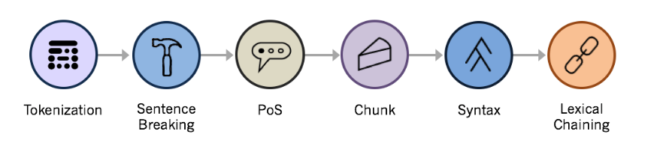
Sentence Chaining
Lexical chaining links individual sentences by each sentence’s strength of association to an overall topic
Notes:
Even if sentences appear many paragraphs apart in a document, the lexical chain will flow through the document and help a machine detect over-arching topics and quantify the overall “feel”.

Slide 23
Task: Data Preprocessing
Remove Stopwords
Replacing non-ASCII characters with spaces
Removal of HTML tags and punctuations
Lowercase all messages
Remove emoticons

Slide 24
Lab Assignment
Using Jupyter notebook, apply data preprocessing techniques to the Hate Speech dataset in the link below. The notebook should also contain a summary of insights gained from exploratory data analysis.
https://www.kaggle.com/datasets/edwardombui/hatespeech-kenya

Slide 25
References
Data preprocessing in Machine Learning
https://www.careers360.com/courses-certifications/articles/data-preprocessing-in-machine-learning

